Slide 1
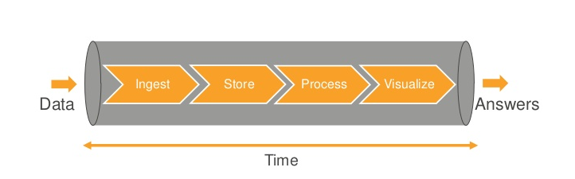
Data Analytics Pipeline

Slide 2
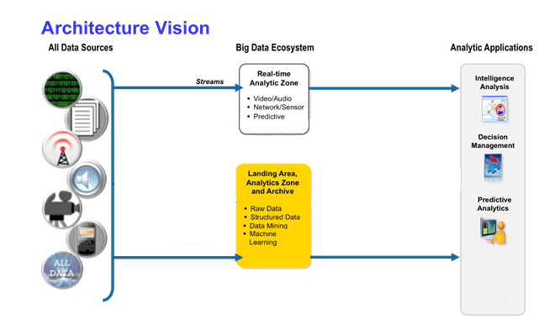
Architecture Vision

